Slide 1
Reading:
Robert Allen (2017): The Industrial Revolution: A Very Short Introduction
Brad DeLong
Department of Economics and Blum Center, U.C. Berkeley; and WCEG
last revised: 2020-02-20
Original course by Melissa Dell (Harvard Econ 1342), revised by Brad DeLong
<https://github.com/braddelong/public-files/blob/master/reading-robert-allen-ir.pptx>

Slide 2
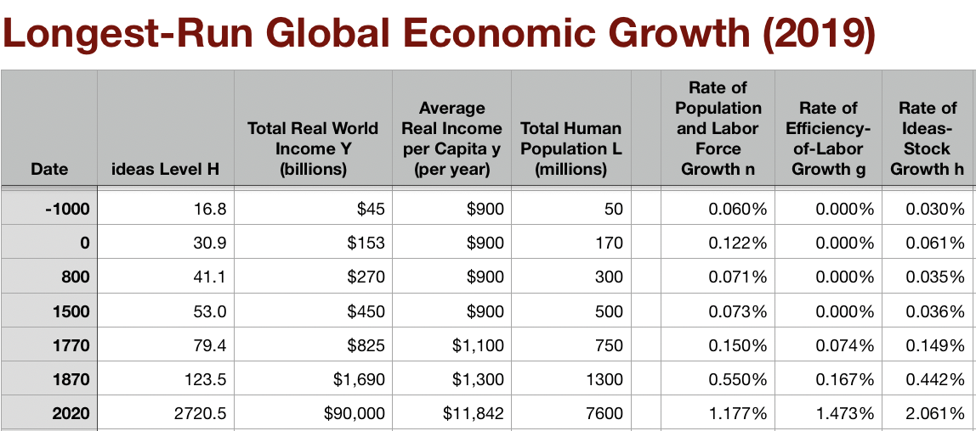
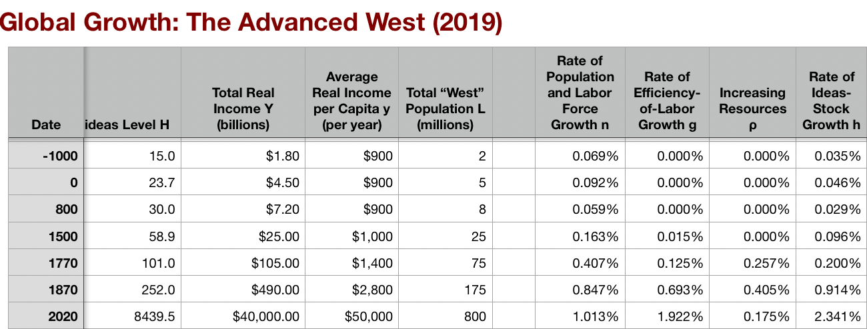
Adam Smith Had No Clue…
We have market economies throughout Eurasia, at least—i.e., places where becoming a merchant drawing on sophisticated artisanal producers is a road to wealth, even if not the road…
We have governments smart enough—or constrained enough—not to kill the goose that lays the golden eggs, at least not quickly…
We have what looks like worldwide growth at a faster pace after 1500—one that calls forth a demographic response…
Commercial Revolution sees shared global prosperity—but with Atlantic Europe grabbing the lion’s share primarily via empire…
Post-1770 in the North Atlantic we have growth that outruns any possible demographic response, and triggers the demographic transition…
Why? And how?
Post-1870 we have a further acceleration to modern economic growth…
9:50-10:00

Slide 3
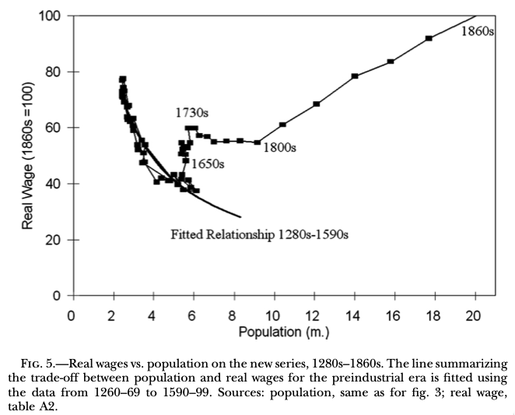
England Before 1800 Not Much Special
1265-1345: High Middle Ages…
1355-1475: Bubonic Plague and socio-economic aftermath…
1475-1595: Malthusian Demographic Recovery…
1595-1775: Profits of Atlantic Seaborne Empire…
1775-1845: Demographic explosion, with little or no trickle-down…
John Stuart Mill (1848 and 1871): “It is questionable if all the mechanical inventions yet made have lightened the day's toil of any human being. They have enabled a greater population to live the same life of drudgery and imprisonment…”
http://faculty.econ.ucdavis.edu/faculty/gclark/papers/secret2001.pdf

Slide 4
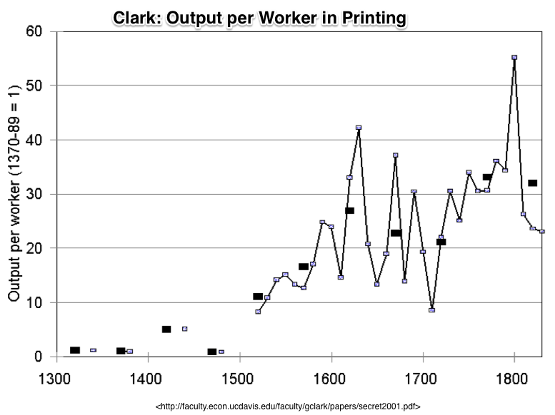
Compare to: Earlier “Industrial Revolution” in Printing Had No Direct Macro Impact…
A thirtyfold fall in the price of books from 1375 to 1775…
ln(30)/400 = 0.85%/year
But books are 1% of production…
So: 0.0085%/year
0.85%/century
3.4% over four centuries
That’s the direct effect…

Slide 5
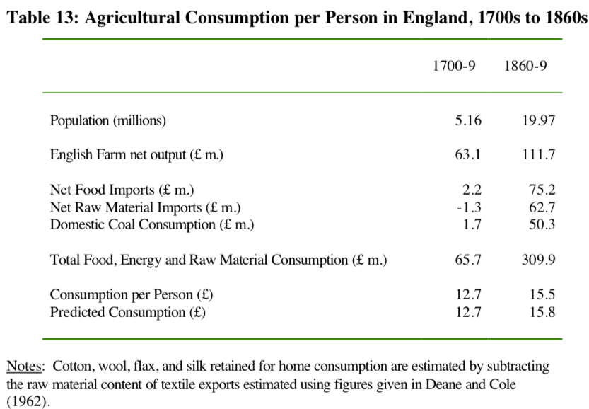
The Relocation of Global Industry to England
Clark: “The population fed and clothed by English agriculture did not expand from 7.5 million to 21 million between 1760 and 1860… from 7.5 to 9.6 million…”
Gets into the business of combining cotton, imported food, coal, and British and Irish workers to make the world’s textiles, iron, machines, and ‘protection’…
A huge shift…

Slide 6
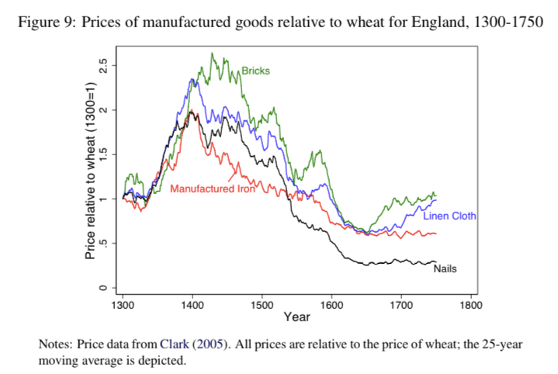
Huge Swings in Relative Price with Stable Technology

Slide 7
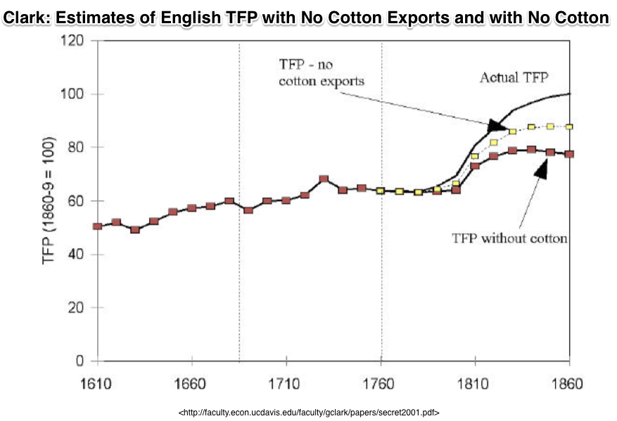
Cotton Is King! (Plus Iron and Steam)
The English ability to make clothes out of cotton in factories for domestic consumption was a 10%-of-everything gain by 1860…
The English ability to export cotton goods was another 10%-of-everything gain…
That’s 0.4%/year in a country growing its productivity level at 0.9%/year…
And iron and other steam are another 0.3%/year

Slide 8
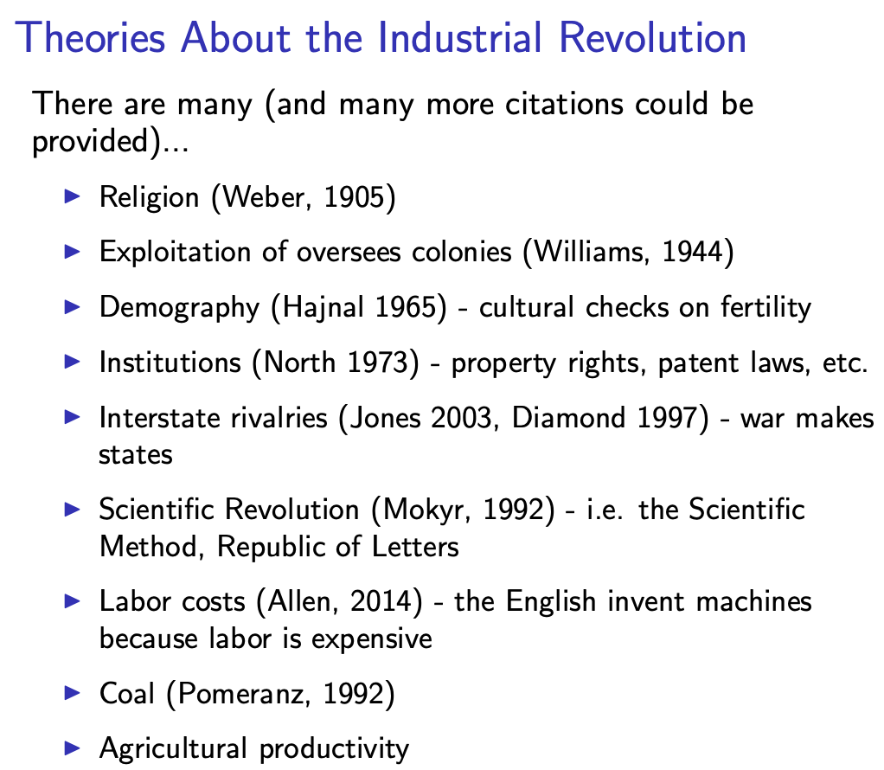
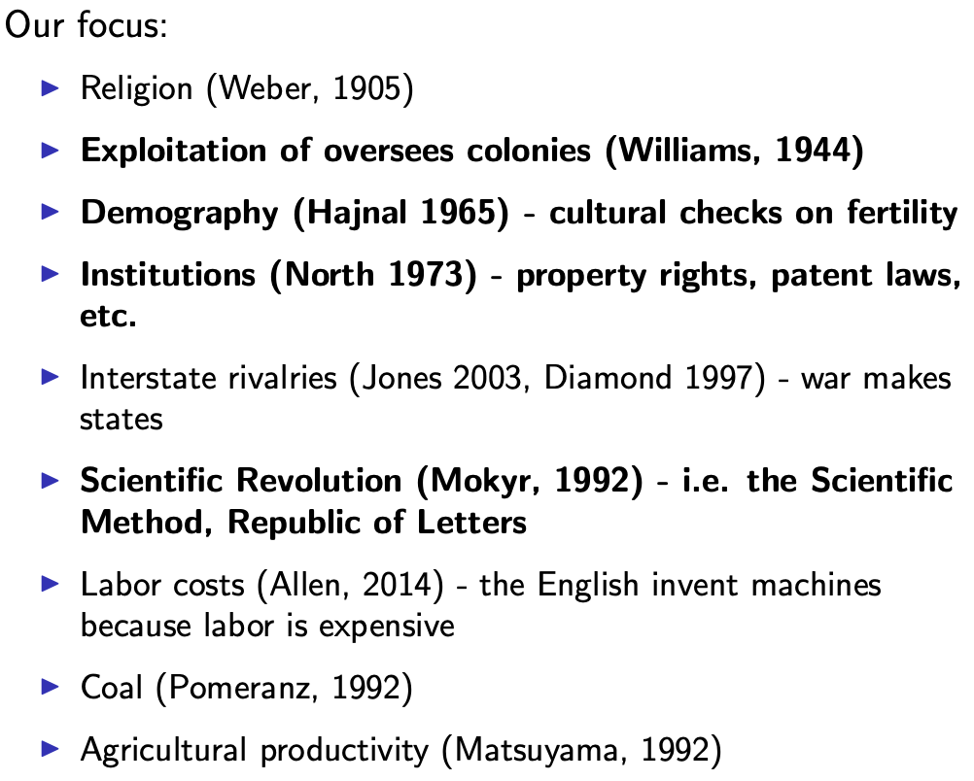
Many, Many Theories About the Industrial Revolution
Melissa Dell takes the “institutional” approach…
9:45-10:00
Slide taken from Melissa Dell

Slide 9
I Am Going to Take Allen’s Approach: Factor Prices & Empire
Robert Allen (2017): The Industrial Revolution: A Very Short Introduction <https://delong.typepad.com/files/allen-industrial.pdf>, chs. 3, 5-6:
Technological change is the motor that powers economic growth:
A technological revolution was at the heart of the Industrial Revolution
Abraham Darby’s successful smelting of pig iron with coke rather than charcoal in 1709…
Huntsman revolutionized the production of steel with the crucible process in the 1740s
Henry Cort did the same for wrought iron manufacture with the puddling and rolling processes in the 1780s.
James Hargreaves invented the spinning jenny in the 1760s
Richard Arkwright invented the water frame in the 1770s
Samuel Crompton invented the self-acting mule in the 1780s
Power weaving by Edmund Cartwright around 1785
The steam engine by Thomas Newcomen in the early 1700s
Steam engine improvement by James Watt in the 1760s

Slide 10
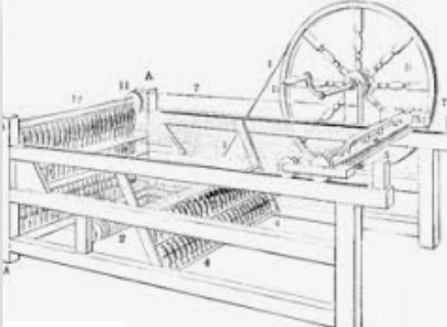
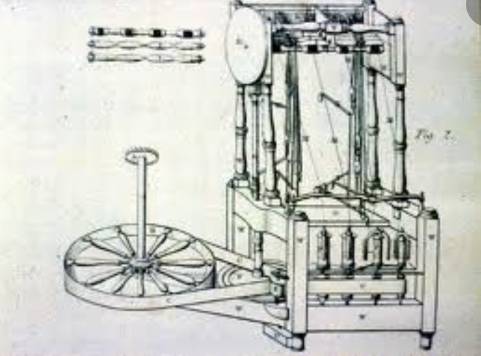
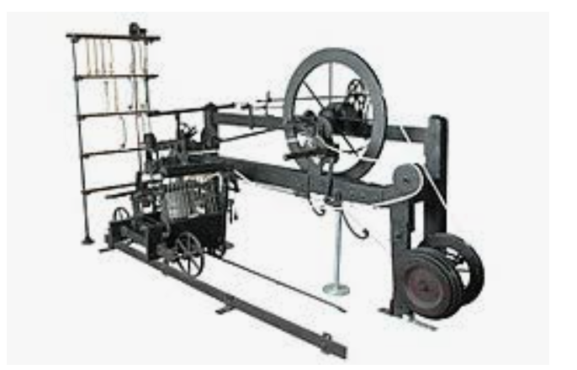
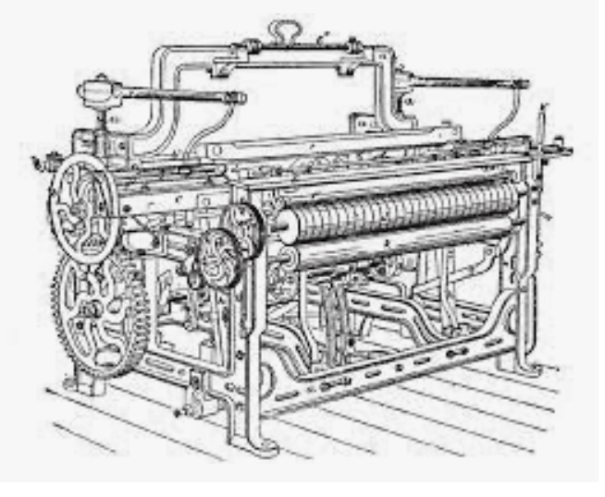
What Do These Look Like?
Spinning jenny, water frame, self-acting mule, Cartwright’s power loom:

Slide 11
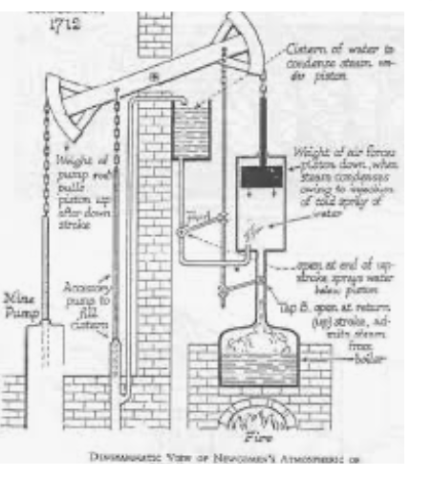
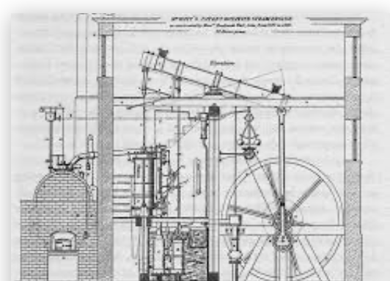
What Do These Look Like?
Newcomen and Watt

Slide 12
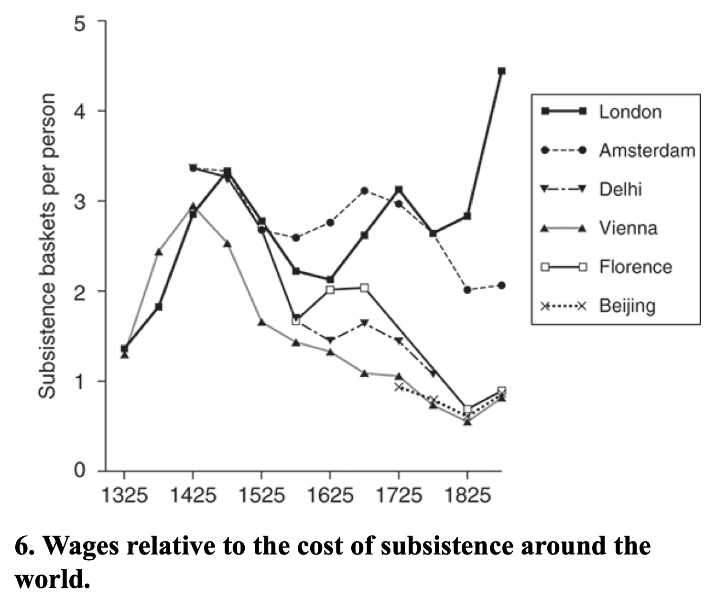
Background Factors
Allen (2017): “Institutions, practices, and culture that supported technological innovation and business investment, they were not sufficient on their own to explain the Industrial Revolution. Other parts of the world were equally blessed, but they did not have industrial revolutions…”:
Specific triggers…
Empire, commerce, and real wages…
Cotton—a fiber that could be worked by machine…
Factories…
Coal…
& steam engines…

Slide 13
Steam Engines
“The reason it was profitable to develop the Newcomen engine in Britain was because there were coal mines to be drained “:
The science underlying the steam engine was pan-European
The research and development (R&D) was carried out in Britain by an Englishman
James Watt, FRS: The Industrial Enlightenment

Slide 14
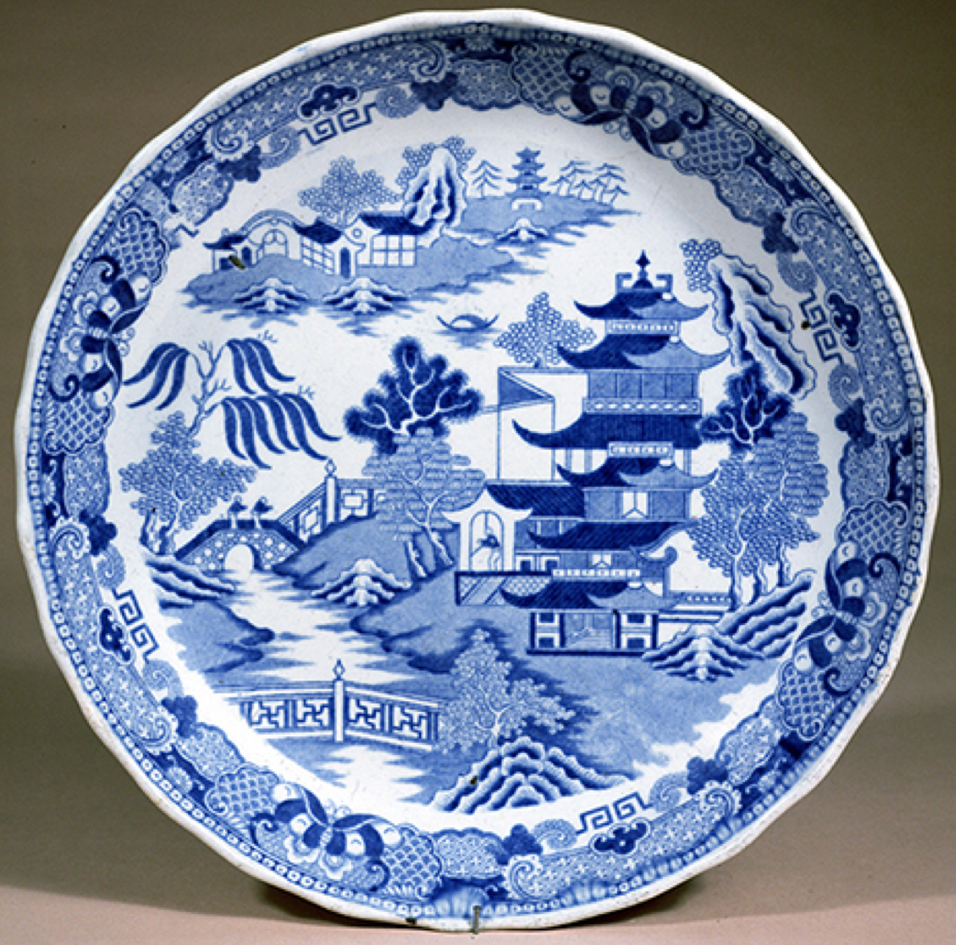
English vs. Chinese Pottery Kilns
Energy prices mattered—a lot:
England developed methods that differed fundamentally from those used in China. In both countries, technology evolved in the direction of reducing the use of expensive inputs while increasing the use of cheap ones…
English-style kilns had a coal fire in the bottom. The heat rose, enveloped the pots, and then vented out of the furnace through a hole in the top…
Chinese kilns used lots of capital to preserve energy. They consisted of a series of chambers rising up a hillside. A fire burned at the entrance to the lower chamber where the heat was drawn in to bake the pots. The heat was not vented out of a hole in the top in the English manner. Instead, it was forced down through a hole at floor level and entered the next chamber up the hill…

Slide 15
Steam Engines
165K HP in 1830, 2.1M HP in 1870:
1712: Newcomen: 5 HP
1733: 1K HP (100 engines)
1775: 9K HP (600 engines)
1800: 40K HP (500 Watt, 1500 Newcomen engines)
1830: 165K HP
1870: 2.1M HP

Slide 16
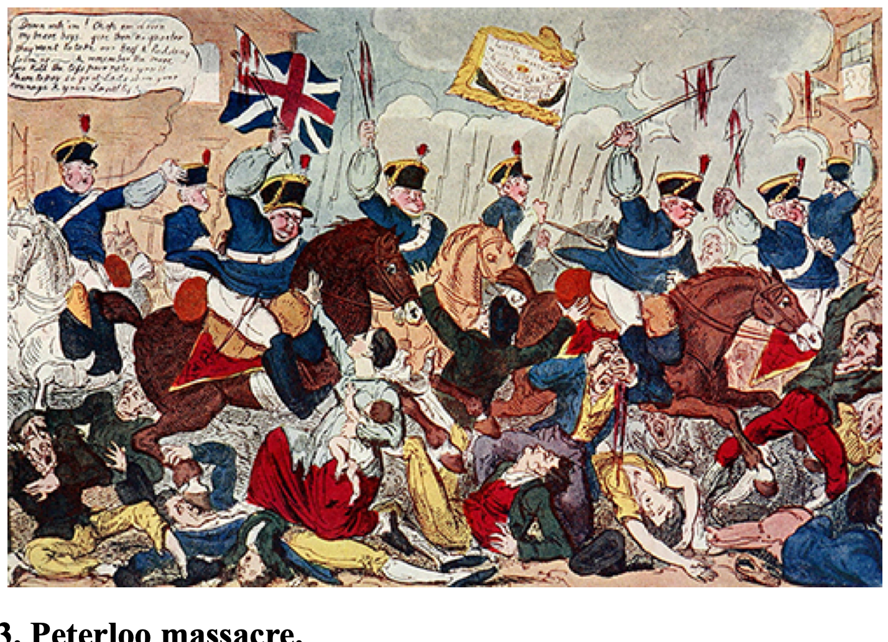
Allen: Reform and Democracy
Robert Allen (2017): The Industrial Revolution: A Very Short Introduction <https://delong.typepad.com/files/allen-industrial.pdf>, chs. 3, 5-6:
Enlightenment, literacy, pamphlets, The Rights of Man (sells 1 million copies), & the French Revolution
60,000-strong Manchester demonstration in 1819: eleven killed: “Peterloo”
“Reform that we may preserve”: 1832 Reform Bill
Virtual representation
Divide the reformers
1833: Factory Act—9-hour day for children under 12
1834: New Poor Law—workhouses

Slide 17
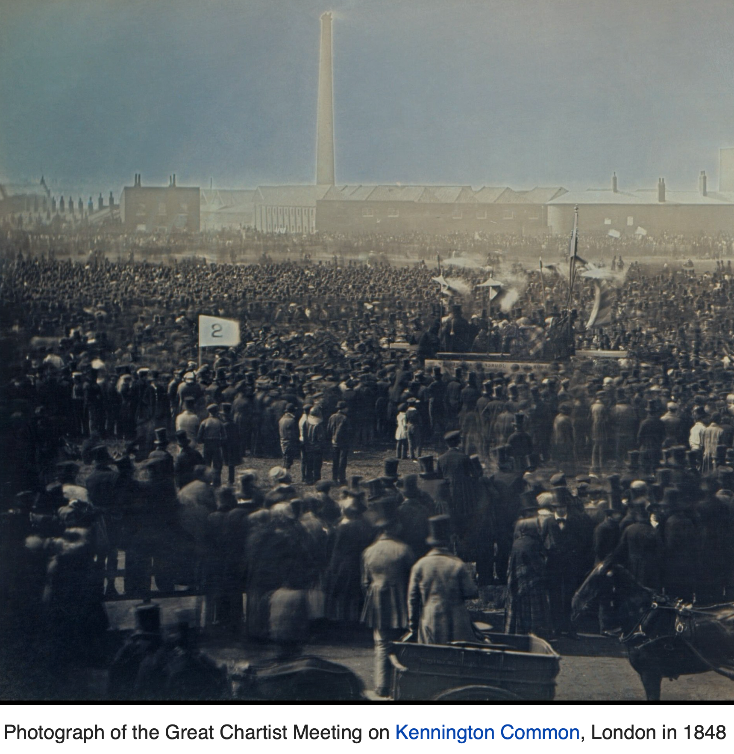
Allen: Reform and Democracy II
Robert Allen (2017): The Industrial Revolution: A Very Short Introduction <https://delong.typepad.com/files/allen-industrial.pdf>, chs. 3, 5-6:
1833: Factory Act—9-hour day for children under 12
1834: New Poor Law—workhouses
1838: People’s Charter
1846: Corn Law Repeal
The “condition of England”
John Stuart Mill (1848 and 1871): “It is questionable if all the mechanical inventions yet made have lightened the day's toil of any human being. They have enabled a greater population to live the same life of drudgery and imprisonment…”
1846-67: Real wage stagnation ends: average consumption per head in working class families rose by 42 per cent…

Slide 18
The People’s Charter
The People's Charter called for six reforms to make the political system more democratic:
A vote for every man twenty-one years of age, of sound mind, and not undergoing punishment for a crime.
The secret ballot to protect the elector in the exercise of his vote.
No property qualification for Members of Parliament in order to allow the constituencies to return the man of their choice.
Payment of Members, enabling tradesmen, working men, or other persons of modest means to leave or interrupt their livelihood to attend to the interests of the nation.
Equal constituencies, securing the same amount of representation for the same number of electors, instead of allowing less populous constituencies to have as much or more weight than larger ones.
Annual Parliamentary elections, thus presenting the most effectual check to bribery and intimidation, since no purse could buy a constituency under a system of universal manhood suffrage in each twelve-month period

Slide 19
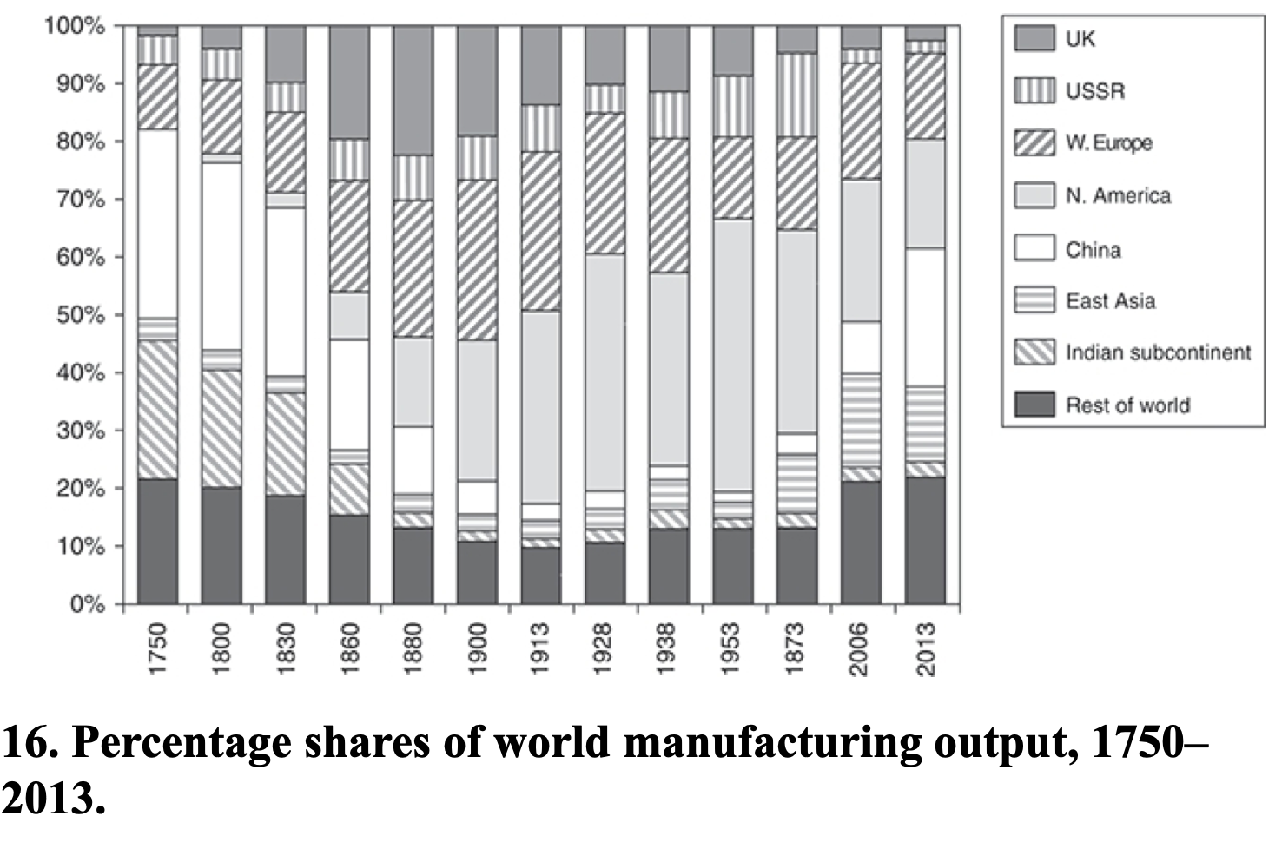
Feb 27: Allen: Spread of Industrialization
Robert Allen (2017): The Industrial Revolution: A Very Short Introduction <https://delong.typepad.com/files/allen-industrial.pdf>, chs. 3, 5-6:
Western Europe: 12% in the 18th century to 28% in 1913
North America: Less than 1% in the 18th century to 47% in 1953
The Pacific Rim share dropped from 4 per cent to 2 per cent in the early 19th century, but then increased to 5 percent in the first half of the 20th century. By 2006, these countries were producing 17 per cent of the world’s manufactures
China in 1953 at 2% of manufacturing was at its all time low. 9 per cent in 2006. 25 per cent in 2013
The Indian subcontinen: 2% of the world’s manufactures in 1973 and only 3% in 2013

Slide 20
Catch Our Breath…
Ask a couple of questions?
Make a couple of comments?
Any more readings to recommend?

Slide 21
Notes

